Slide 1
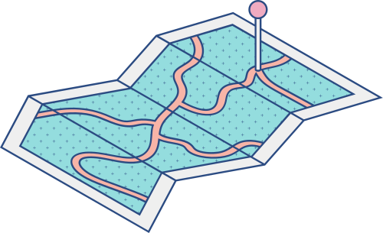





MACHINE LEARNING FUNDAMENTALS
LINEAR REGRESSION

Slide 2
CURRICULUM
1
2
3
4
INTRODUCTION
MATHEMMATICAL ANALYSIS
APPLICATIONS
LIMITATIONS
Introduce the algorithm
and give corresponding
problem
Applications of algorithm in reality
Give some limitations of algorithm
Mathematical formulas
and solutions of equations

Slide 3
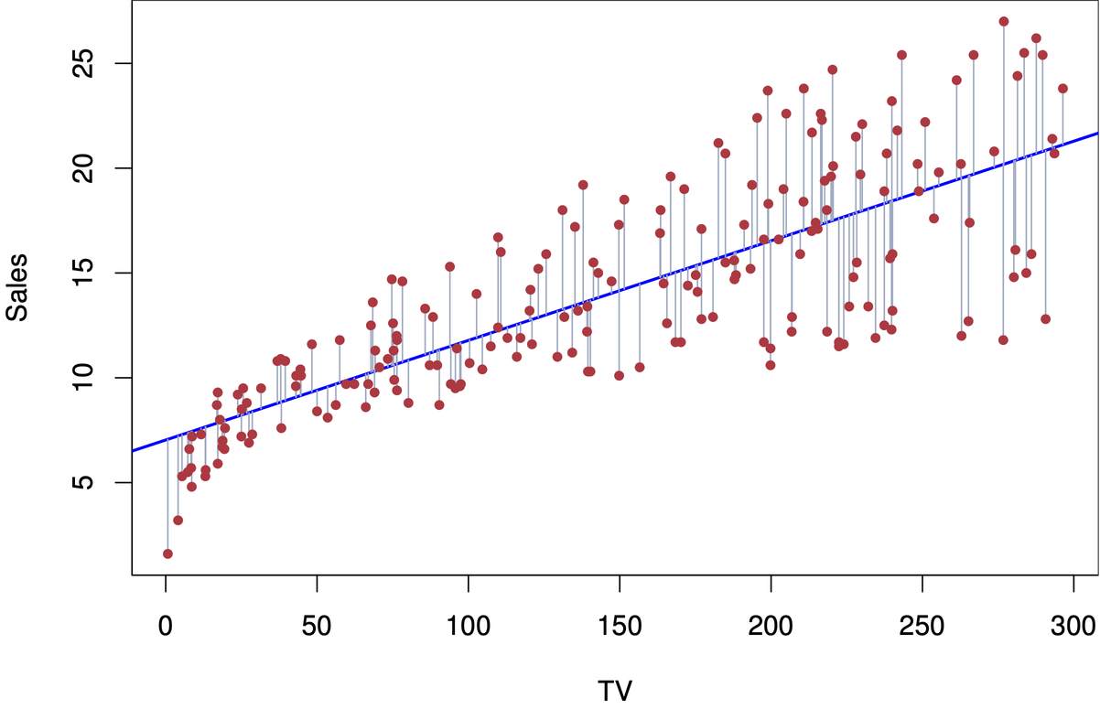
INTRODUCTION
Linear Regression is one of the most basic and simplest algorithms in Machine Learning.
This is supervised learning algorithm.
It is used to model the relationship. between the predicting object and one or more features.

Slide 4

INTRODUCTION
Problem
In a research problem that the value of real estate depends on Area(x1), how many bedrooms(x2), how far from the city center(x3), number of floors(x4),..... and What is the corresponding apartment cost? (y).

Slide 5

INTRODUCTION
X = [x1, x2, x3,....., xN] : Vector contains input informations
W = [w0, w1, w2, x3,...., wN] : Vector contains features
w0 is bias
y : is real value
y^ : is predicted value
-> In general, y and y^ is two different values due to model errors, however, we want that model errors to be as small as possible.

Slide 6


MATHEMATICAL ANALYSIS
Call w = W^T is features vector(column) that needs to be optimized
x = [1, x1, x2, x3,...., xN] is extemded input vector
Equation (1)
Loss funtion:

Slide 7

MATHEMATICAL ANALYSIS
We alway want the loss funtion to be minimal. So, the requirement wil be “find the vector w such that the value of loss funtion is minimal.

Slide 8
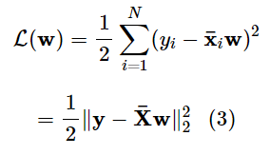

MATHEMATICAL ANALYSIS
To make the loss funtion simpler, we are going convert it to a matrix operation
is the Euclidean norm (Euclidean norm, or Euclidean distance), in other words x is the sum of the squares of each element of the vector. At this point, we have a simple form of the loss function written as equation (3).

Slide 9

MATHEMATICAL ANALYSIS
The most common way to find the solution in optimization problem is to solve the dericative equation.
Derivative with w of the loss funtion:

Slide 10


MATHEMATICAL ANALYSIS
the zero derivative equation is equivalent to:
Call A =

Slide 11


MATHEMATICAL ANALYSIS
Skip some complicated tranformations. We will infer the solution of the equation.
If A is an invertible matrix:
the equation have unique solution:
If A is not an invertible matrix:
solution of equation:

Slide 12
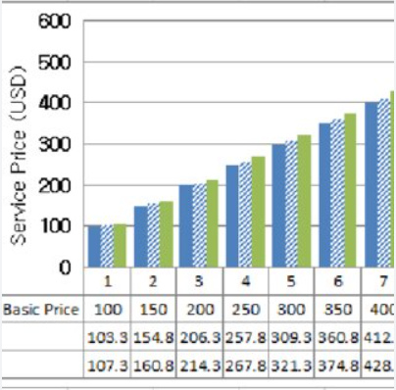
APPLICATIONS
Estimate a continuous value
Sale forecasting
Satisfaction analysic
price estimation
Employment income

Slide 13
LIMITATIONS
Sometimes the linear assumption is not true in real problems.
Having difficulty modeling complex problems.
Sensitive with interference.

Slide 14
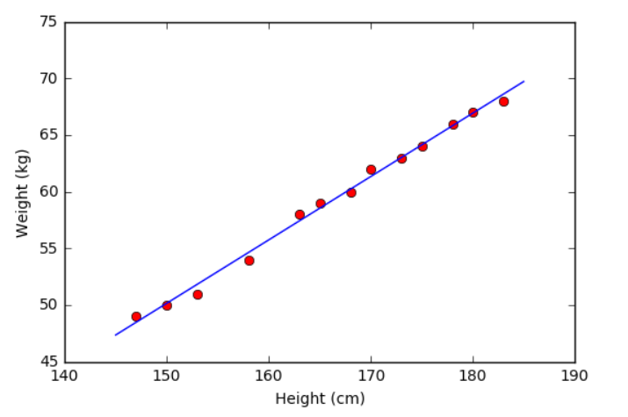
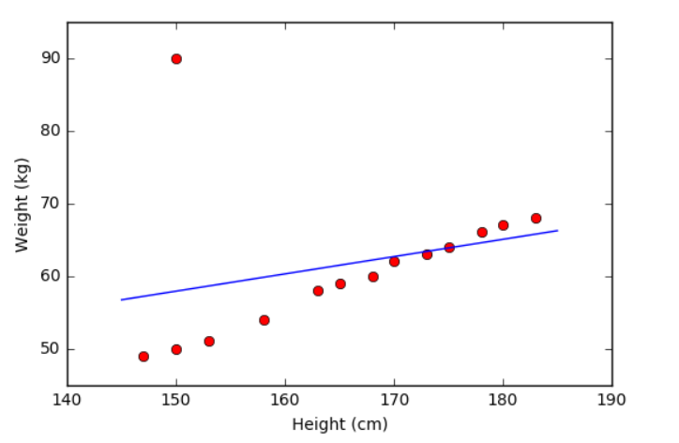
LIMITATIONS

Slide 15
END

